Slide 1
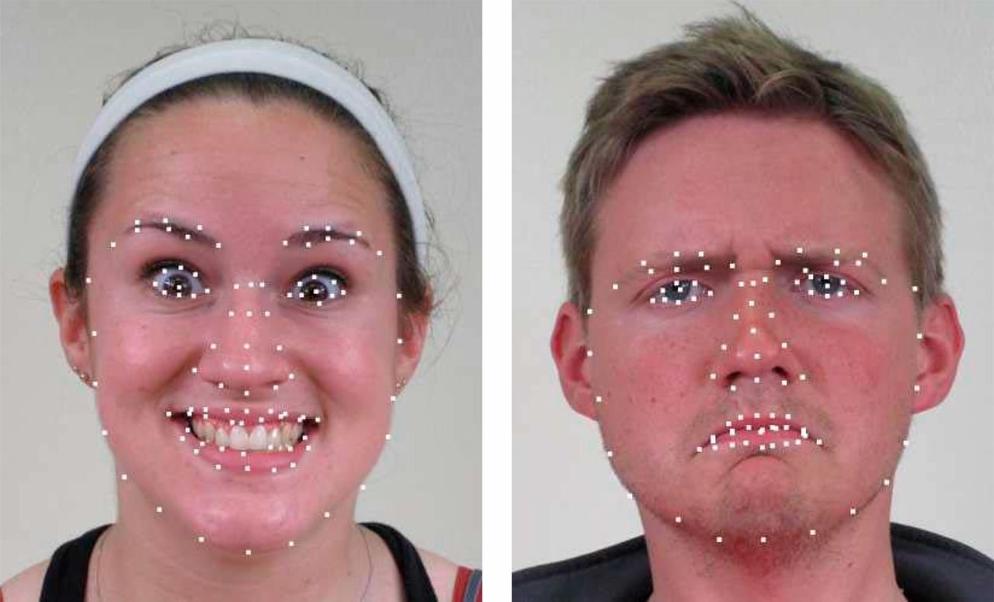
Predictive Analytics for Facial Emotion Recognition
STAT GR5243: Applied Data Science
By: Rui Cao, Luyue Chen, Tong Dai, and Daniel Weiss

Slide 2
Overview
Objective:
Create an Artificial Intelligence program that recognizes emotion from facial images
This will allow you to:
Get natural, accurate responses to products, advertisements, and designs
Independently measure many reactions in individual settings
Solution
Our baseline uses Boosted Decision Stumps (GBM)
35.5% accuracy
We tested several models and found Neural Network modeling to be the most effective:
71.3% accuracy

Slide 3
Data:
Training set of 2,500 photos with 78 data points mapping specific shape landmarks
Created a set of data which compares absolute horizontal and vertical distances pairwise between each point for 6006 data points for each subject.
Also tried Euclidean distance
22 emotional labels
Challenges:
Facial responses can vary significantly between subjects
Methods:
GBM
SVM
XG Boost
Neural Networks

Slide 4
Boosted Decision Stumps (GBM)
Decision stumps are a one level decision tree, by boosting them we can create a set of weak learners that produce stronger results
New trees are fit to a modified version of the original data set
Simple, produces a good baseline but less effective when looking at many features
 | Training |  | Testing
 | Performance | % Improvement | Performance | % Improvement
Accuracy: | 35.50% | 0% | 35.50% | 0%
Running Cost: | 1318.8s | 0% | 1318.8s | 0%

Slide 5
XGBoost
Extreme Gradient Boosting
Uses decision trees and gradient boosting to predict structured data
Tuned with gamma (=0) and a maximum tree depth of 6
Results show great performance improvement in prediction. XGBoost improves on the original GBM model so this is to be expected
 | Training
 | Performance | % Improvement
Accuracy: | 43.60% | 0%
Running Cost: | 1456.38s | 0%

Slide 6
SVM
Representation of data as points in N-dimensional space, mapped to separate categories into the same spaces.
Maximizes the distance between the points and the planes separating spaces
With many features, SVM shows small time improvement, but very large performance improvement
 | Training
 | Performance | % Improvement
Accuracy: | 45.40% | 0%
Running Cost: | 34.86s | 0%

Slide 7
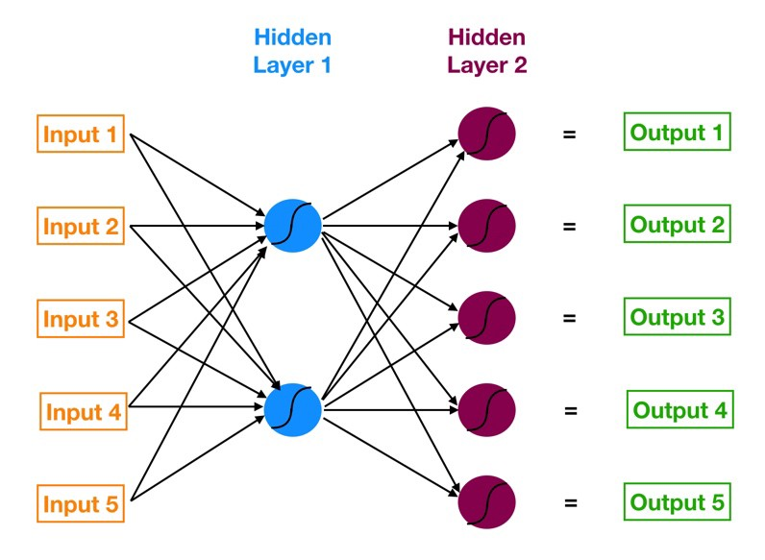
Neural Networks
Can learn tasks without being given specific rules
Have multiple layers of “neurons” hidden that classify and make predictions. Different connections carry different weight, transforming each input
Results in very effective predictions, can be computationally expensive when training
1
 | Training |  | Testing
 | Performance | % Improvement | Performance | % Improvement
Accuracy: | 60.8% | 0% | 60.8% | 0%
Running Cost: | 677.7s | 0% | 677.7s | 0%
1. https://towardsdatascience.com/understanding-neural-networks-19020b758230

Slide 8
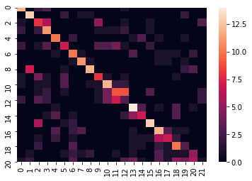
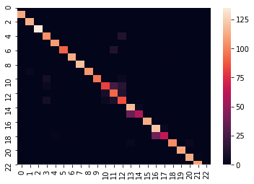
Neural Networks Performance
Confusion Matrices for Baseline GBM and Neural Networks
Confusion Matrix for GBM Output
Confusion Matrix for Neural Network Training Output

Slide 9
Results
 |  | Training |  | Testing
 |  | Performance | Improvement % | Performance
GBM | Accuracy: | 35.50% | 0%
 | Running Cost: | 1318.8s | 0% | 0.485s
SVM | Accuracy: | 43.60% | 22.8%
 | Running Cost: | 1456.38 | -10.4% | 84.390s
XGBoost | Accuracy: | 45.4% | 27.9%
 | Running Cost: | 34.86s | 2.64%
Neural Networks | Accuracy: | 60.8% | 71.3%
 | Running Cost: | 677.7s | 48.7% | 1.188s

Slide 10
Thank you!

Slide 11
K-Nearest Neighbors
Calculates the distance between data points then groups data into groups of size “K” by smallest differences to find “neighborhoods”
Tuned using different values of K
Simple, easy to implement.
Can be used for classification and regression
Slower when using many data points
 | Time (s) | % Improvement
Performance:
Running Cost:

